Slide 1

Introduction to database
TRAIN TICKETS BOOKING management system

Slide 2
Tech Requirements
Present by:
* Saikat Kotal Shuvo (22-48568-3)
* Mohyminur Rahman Sharif Rishad (22-48586-3)
* Arobindo Ghosh (22-48423-3)
* SECTION – [C]
Course Teacher: Saeeda Sharmeen

Slide 3

Introduction
"Welcome to our train ticket booking system! Here, passengers can easily reserve seats for their desired trains by providing the train number and the date of travel. Our system ensures a smooth booking process by validating the train number and booking date, checking seat availability, and generating unique ticket IDs for confirmed bookings. In cases where all available tickets are booked, a waiting list is initiated to accommodate additional passengers. Moreover, passengers have the flexibility to cancel their bookings at any time using the unique ticket ID. As an added convenience, our system automatically promotes the first ticket on the waiting list to confirmed status upon cancellation. With our efficient and user-friendly system, traveling by train has never been easier!"

Slide 4

Scenario
A user first registers by providing their name, age, phone number, and address. The system assigns a unique user number. * Once registered, the user can then search for trains. Trains are identified by a unique train number (TNo) and have attributes such as source, destination, type (e.g., express, local), class (e.g., economy, business), and fare. * The user can also see the route of the train, including the stop number and name of each stop.* When the user selects a train, the system checks for seat availability. If a seat is available, the user can book it by providing their payment information (card details, bank, etc.) and finalizing the transaction. A unique transaction ID is generated upon successful booking.* The system creates a ticket for the user, which includes their user number, the train number (TNo), source and destination stations, and the seat number. In essence, this ER diagram represents a database system for an online train ticket booking portal.

Slide 5
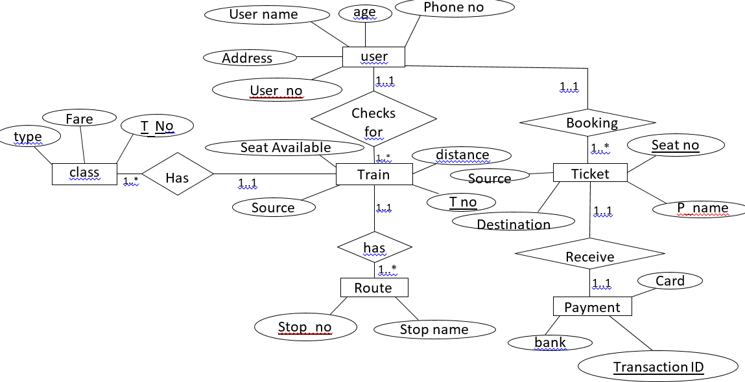
Er diagram

Slide 6
Normalization--- User checks for Train (one to many)
unf (check for):uno, u-age, u_address, u name, u-phoneno, T_no, T_distance,T_seat_avail,T_sources
1nf: U_no(PK),U_age u- add, u-name, u-phone no,T_no, T_ distance, T-seal-avail, T_source.
2nf: U_no (Pk), u-age, u-add, u-name, u phone no
2. T no(pk) T_ dis, T_ seat- avail, T_ source. Uno (fK)
3. U_no(PK), T_no (FK)
3nf : same as 2nf

Slide 7
Train has route (one to many)
Unf :T_no, T_source, T_ seat_ avail, T- distanc,R-Stop-no, R_ stop-name
1nf: T_no(Pk), T_source, Tseat_ avail, T_dis R-stoP_no, R_stoP name
2nf: 1.T_no(pk) T_source, T_ seat_ avail, T- dis
2. R-stoP_no(pk), R_stoP name ,T_no(fk)
3.T_no(pk), R_stop_no(fk)
3nf: same as 2nf.

Slide 8
UserS booking ticket (one to many)
Unf: U_no, U_name, Uphone_no, U-age, U-add, T-seat_no., T_P_ name, T. source, T-des
1nf: Tseat- no (PK), T_P_ name, T-souree, T-des,U-no,U-name,u_phone-no,u-age,U-add
2nf: 1. T_ seat- no (PK), T_P_ name, T_ source, T_des
2. U_nO（PK),U_name U-Phone-no,U-age,U add,T_seat_no(fk)
3.U_NO(PK), T_seat_no(FK)

Slide 9
Ticket receive payment(one to one)
Unf: T_ seat_no P_ name ,T_ source, T des,P_ card, P_ banK, P_ Transaction_ Id
1nf: T_seat_no , T_p_name, T source, T- des, P_ card, P-banK, P_Transaction_ Id
2nf: 1 T_ seat_no. (PK),T_name ,T_ source, T des
2. P_ Transaction_ Id(pk) , P_ card, P-bank, P seat_no(Fk)
3. P seat_no(Fk), P_Transaction_ Id(pk)
3nf: same as 2nf

Slide 10
Train has class (one to many)
Unf: T_no, T. sounce, T-sett avail, T_ distance,C_t-no,C_fare,C_type
1nf: T_no(pk), T. sounce, T-sett avail, T_ distance, C_T-no, C_fare,C_type
2nf: 1. T_no(pk), , T. sounce, T-sett avail, T_ dis
2. C_T-no(PK), C_fare,C_type,T_no(fk)
3. T_no(fk), C_T-no(PK)
3nf: same as 2nf.

Slide 11
FINALIZATION:
1. U_no (PK), U_ age, U_ add, Uname, U- phone no, T_ no (FK). (User - Train)
2 . T-no (PK)，T-distance, T-seat_available, T_souree
3. U-no (PK) , T_no (FK). (checks for)
4. T_seat_ no (PK), T_P_ name, T_source, Ides ( TicKet)
5. U_no (PK), U_name, U-phone -no, U_age, U_add, T_ seat _ no (FK)
6. U_ no (PK) , T_ seat _ no (FK) (BooKing)
7. T_no(PK), T_source, T-distance, T_seat_ available (Train)
8. C-. T_NO (PK) , C_Fare, C_Type, T no(FK), (Train - class)
9. T_no (FK), C_T_ no(PK) (Train has class)
10. T-seat-NO. (PK） T-P_name, T_souee (Ticket)
11. T- seat -no (PK), T-P-no, T_ source, T-des_P_ Transaction _id (fk) - (receive)
12. T-seat _ no (Pk), P- Transaction_ id (Fk)(Tieket receive payment)

Slide 12
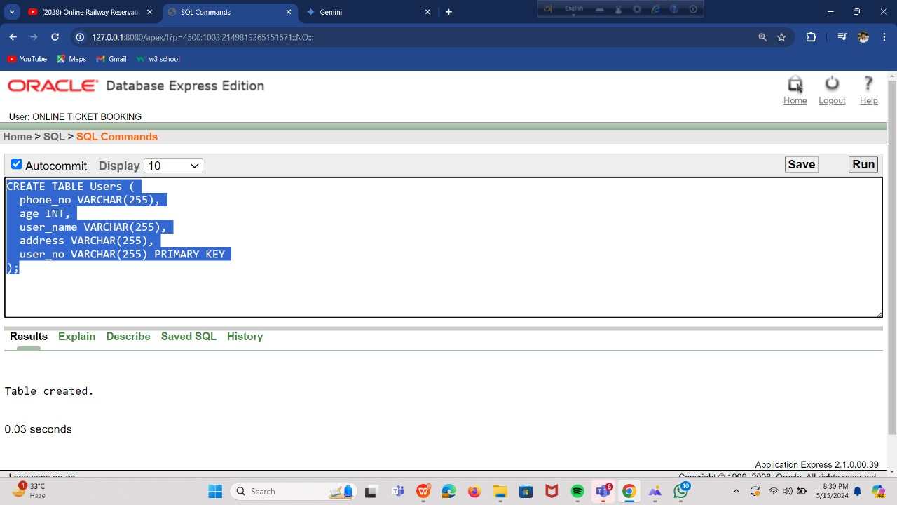
TABLE CREATE: USERS

Slide 13
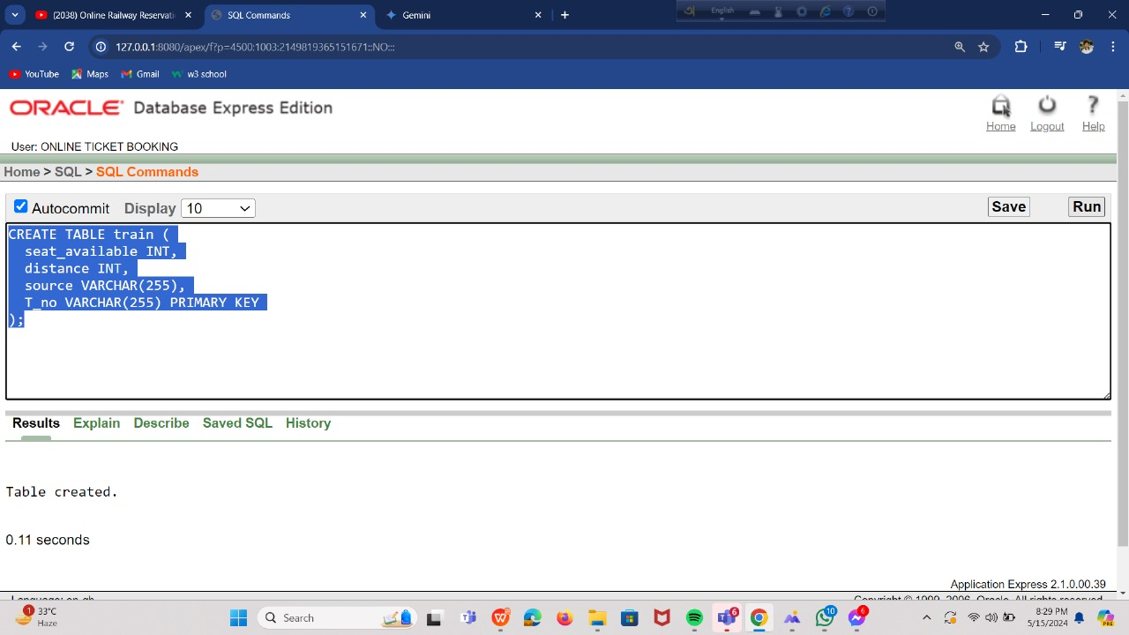
TRAIN

Slide 14
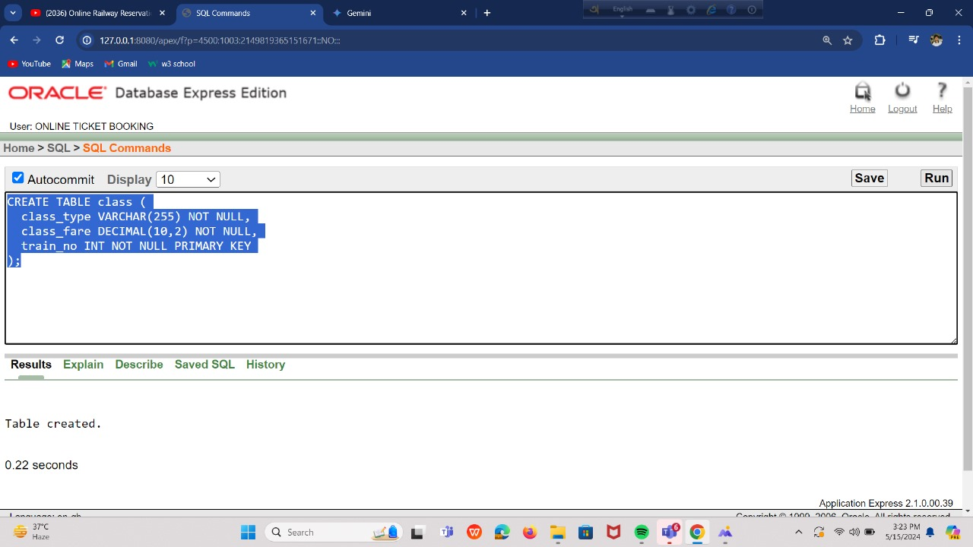
CLASS

Slide 15
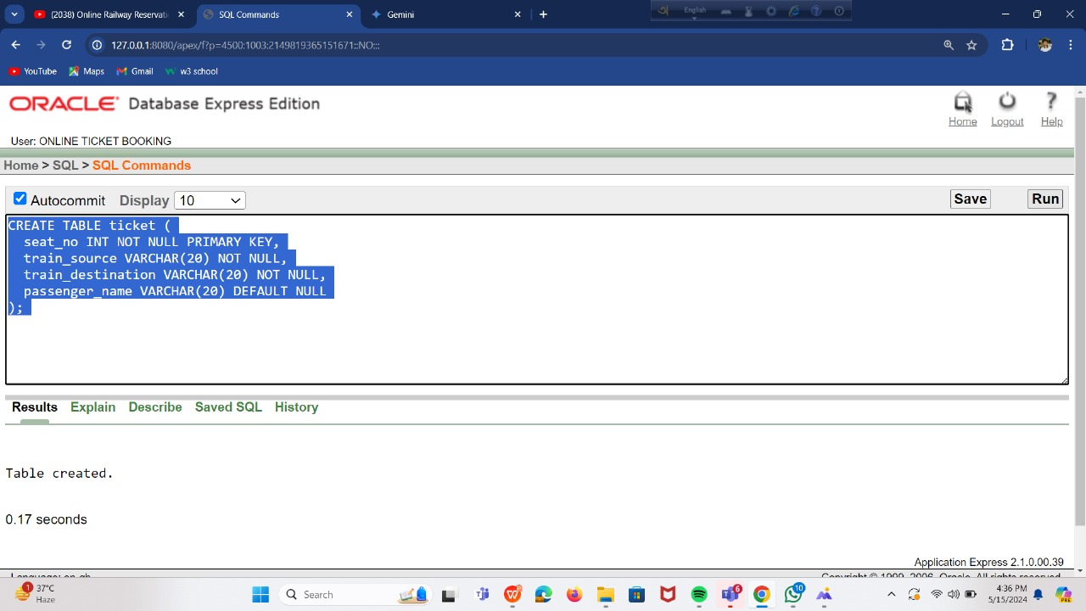
TICKET

Slide 16
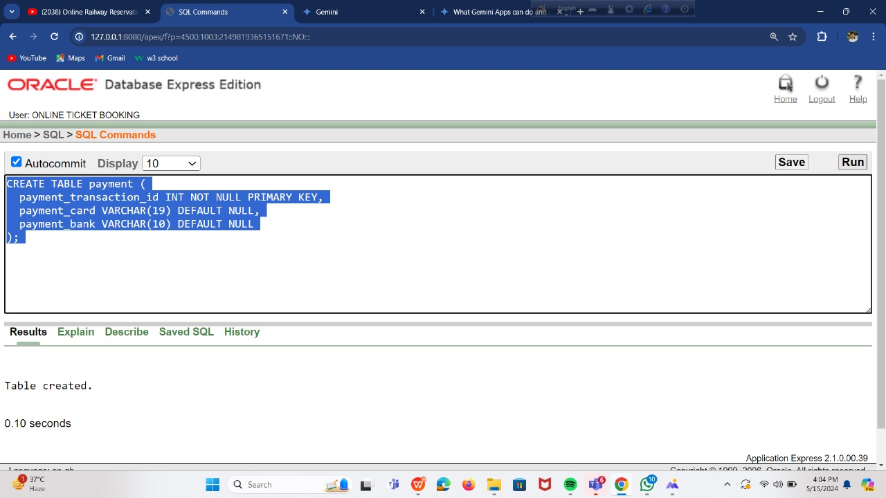
PAYMENTS

Slide 17
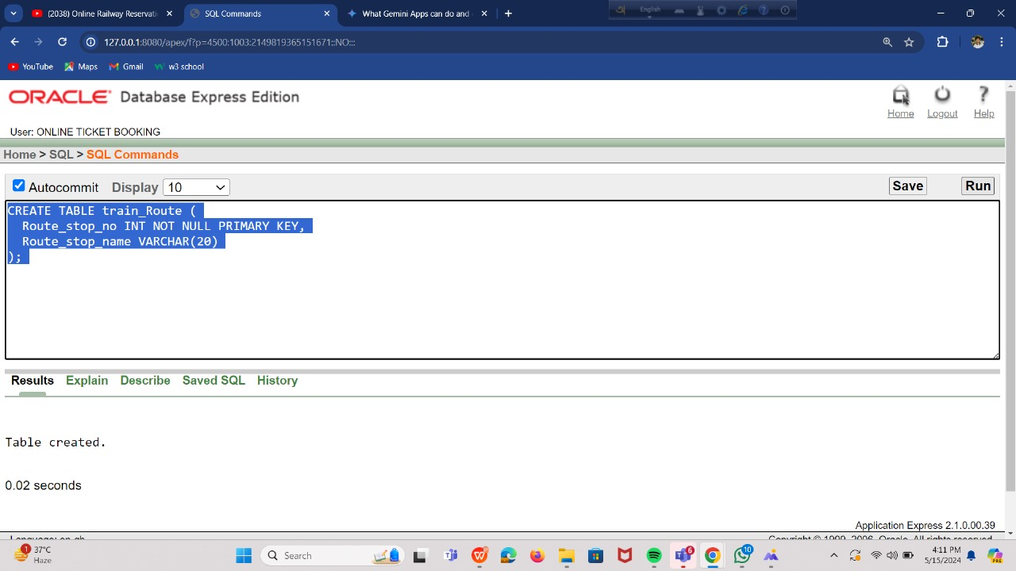
TRAIN ROUTE

Slide 18
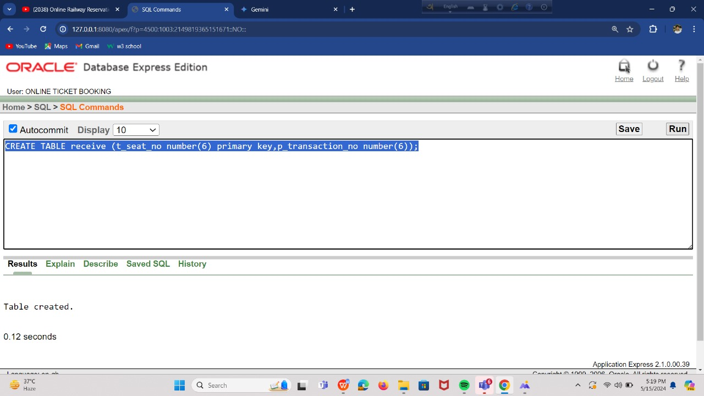
RECEIVE

Slide 19
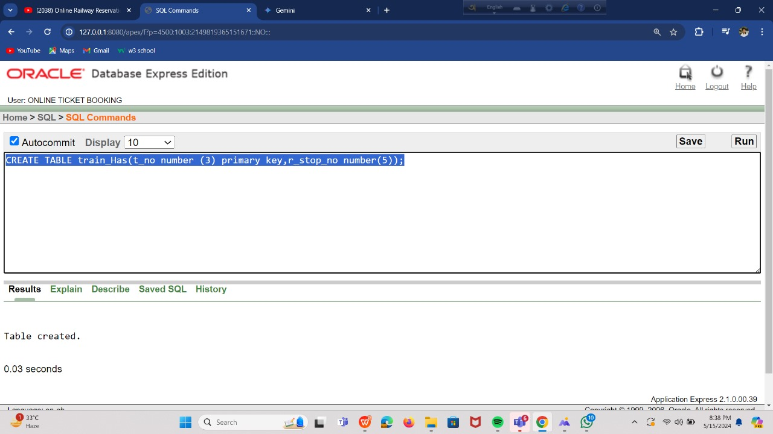
TRAIN HAS

Slide 20
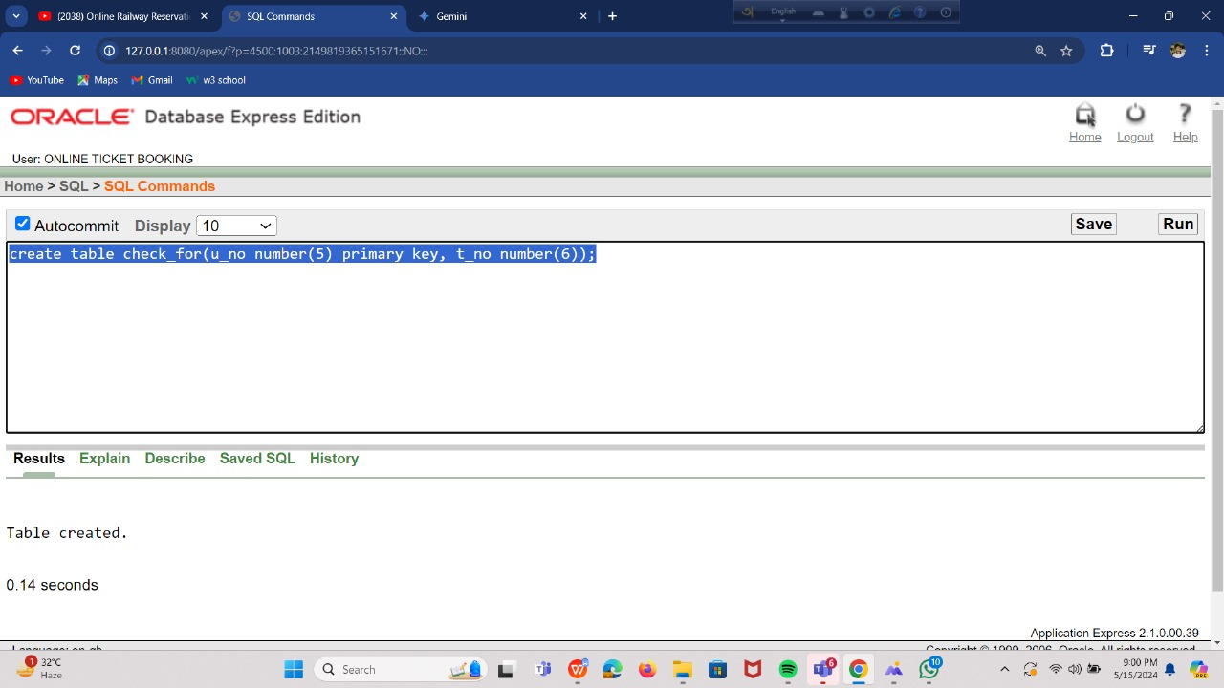
CHECK FOR

Slide 21
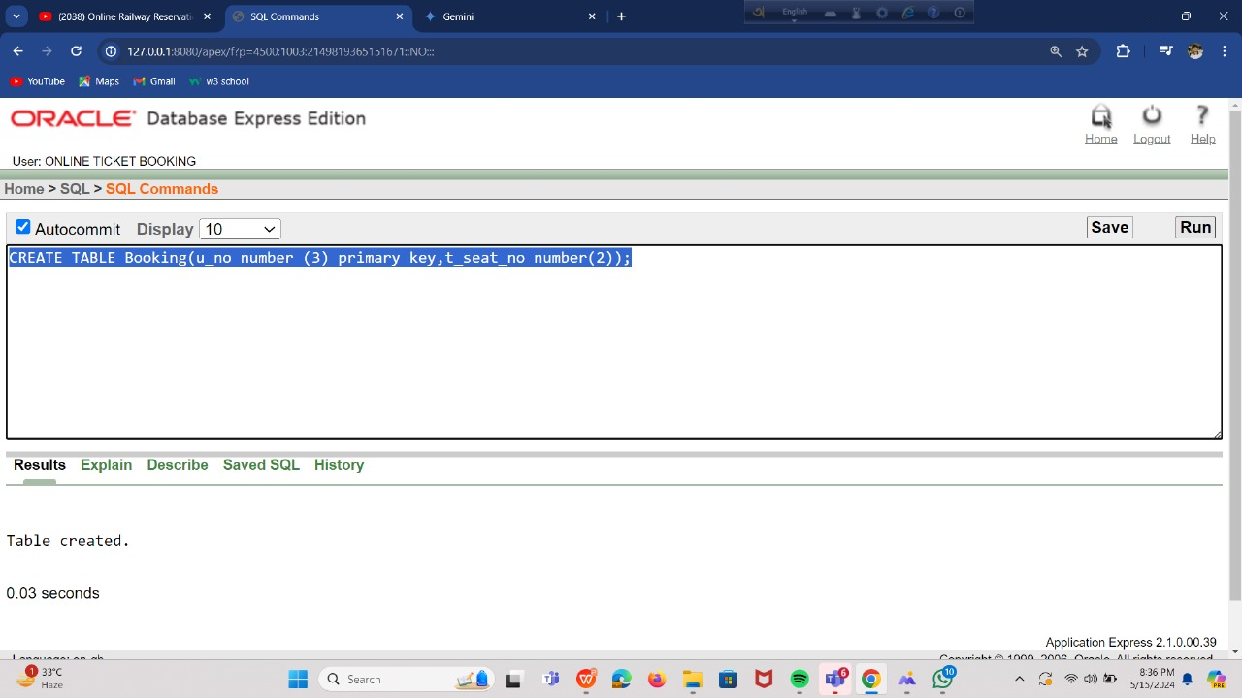
BOOKING

Slide 22
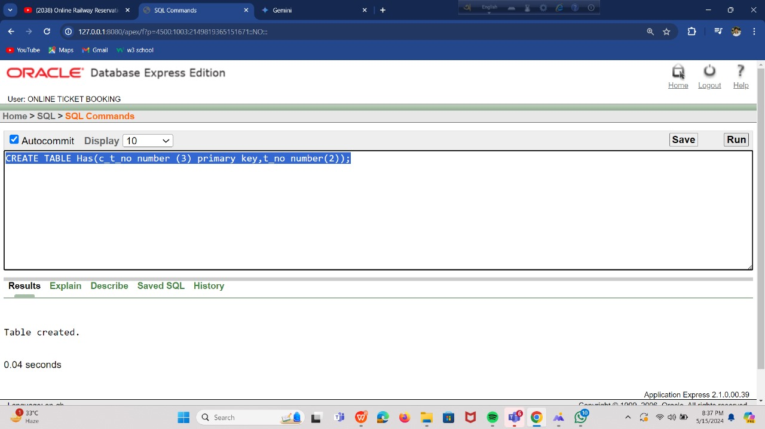
HAS

Slide 23
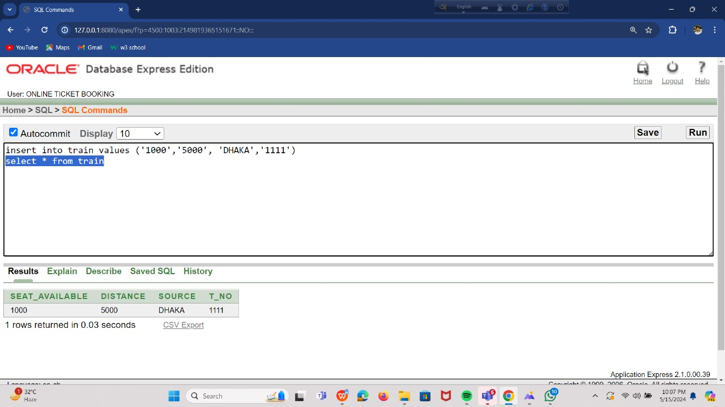
VALUE INSERT: TRAIN

Slide 24
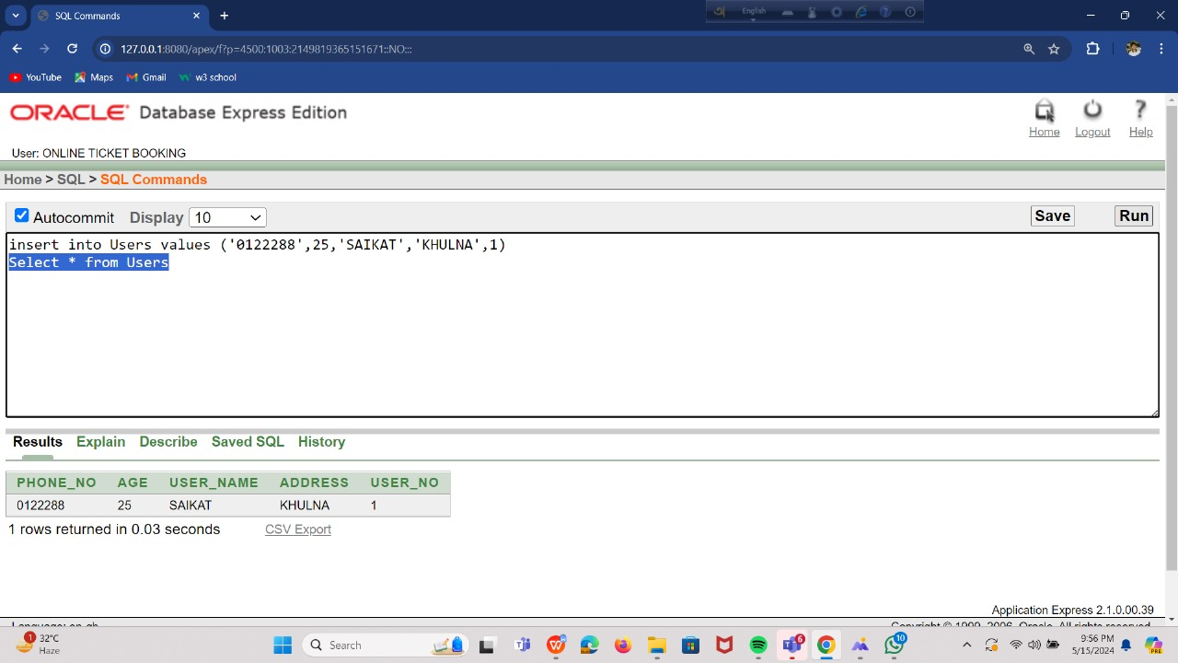
USERS

Slide 25
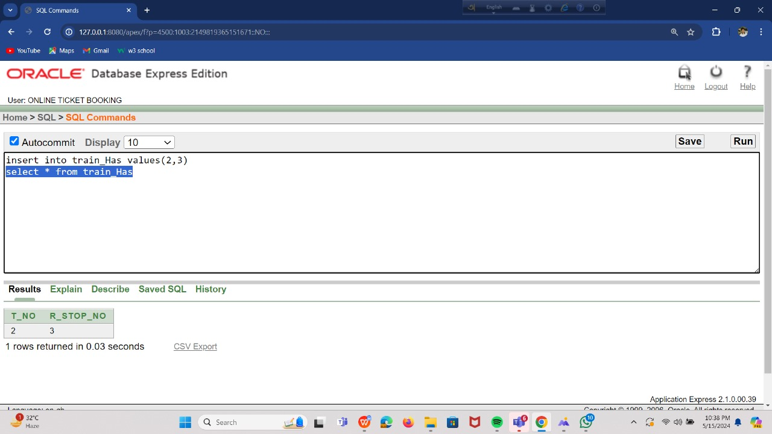
TAIN HAS

Slide 26
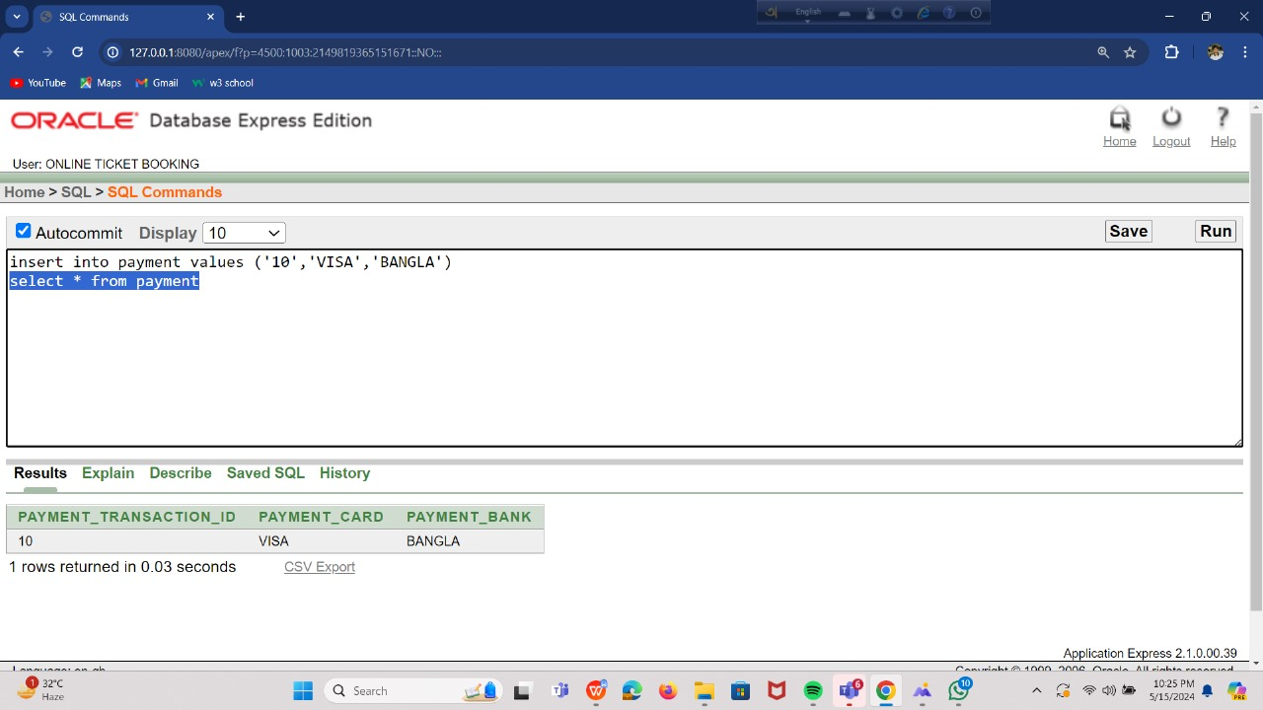
PAYMENTS

Slide 27
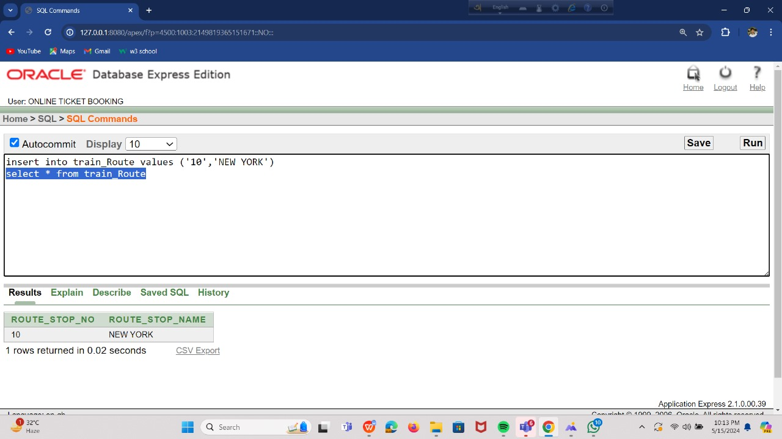
TRAIN ROUTE

Slide 28
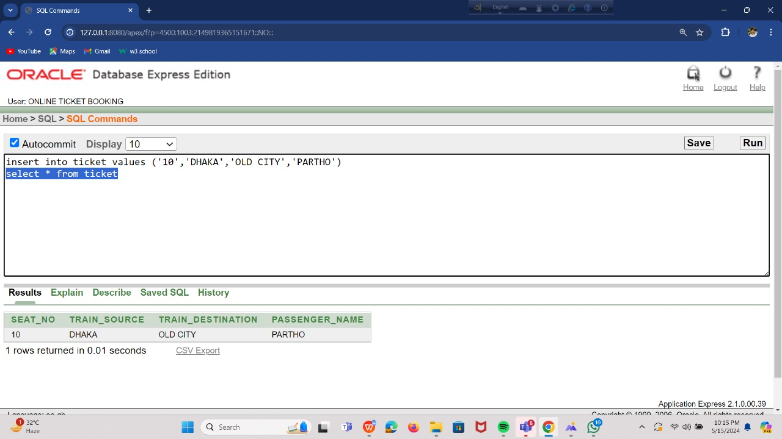
TICKETS

Slide 29
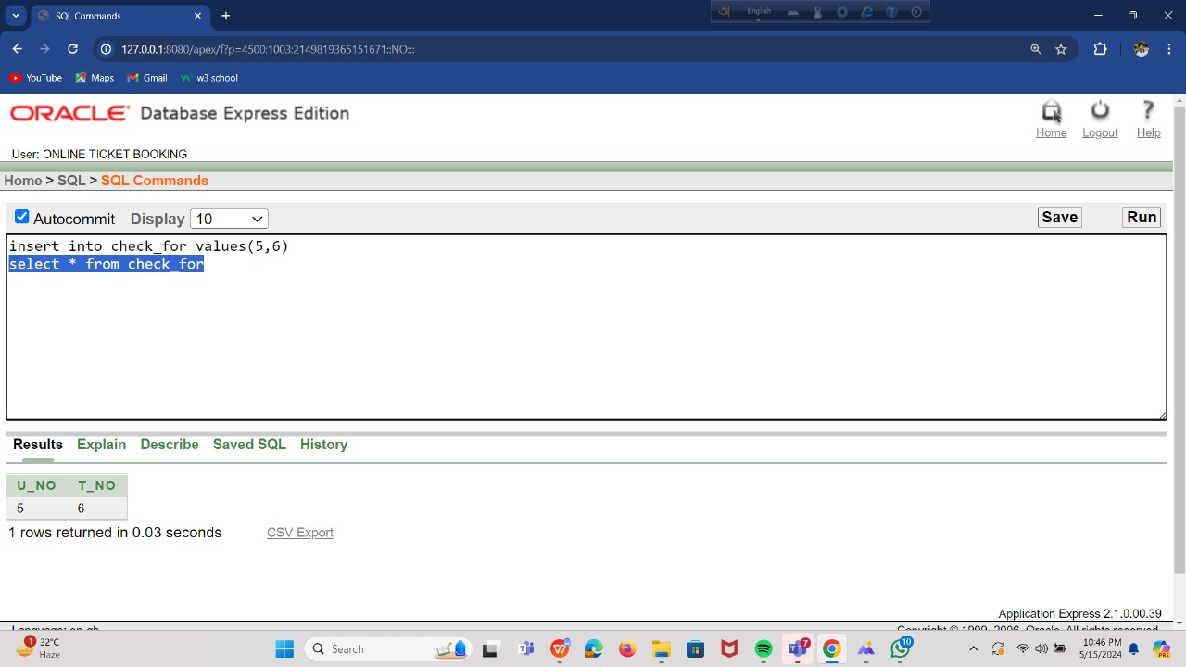
CHECK FOR

Slide 30
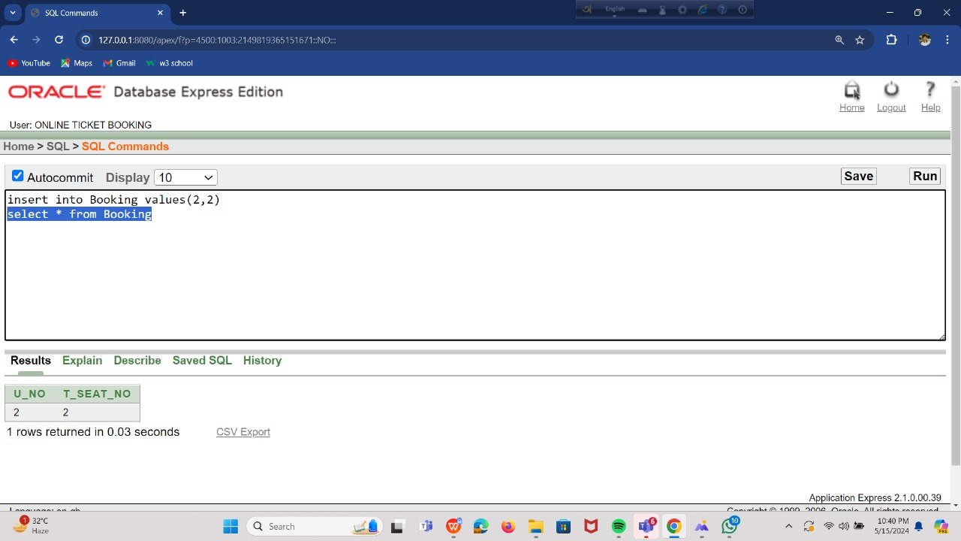
BOOKING

Slide 31
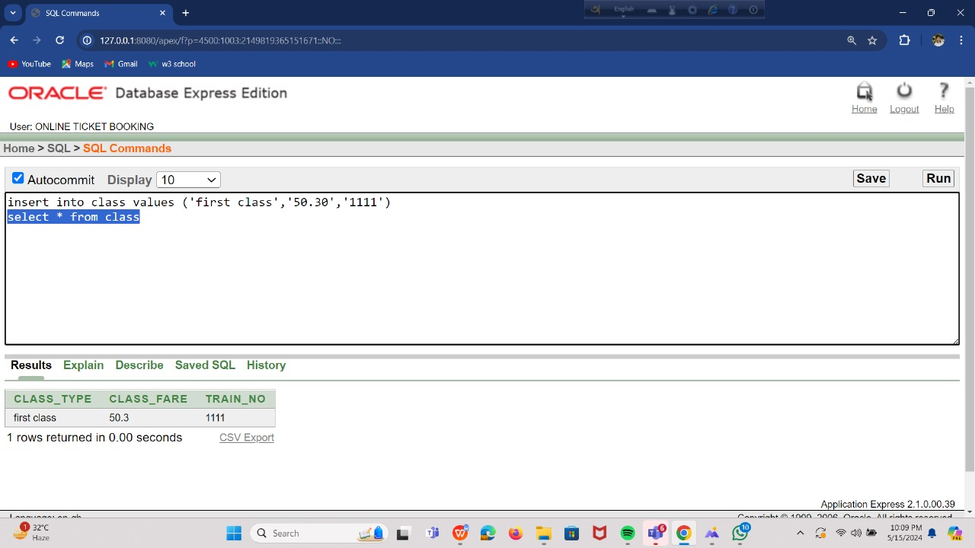
CLASS

Slide 32
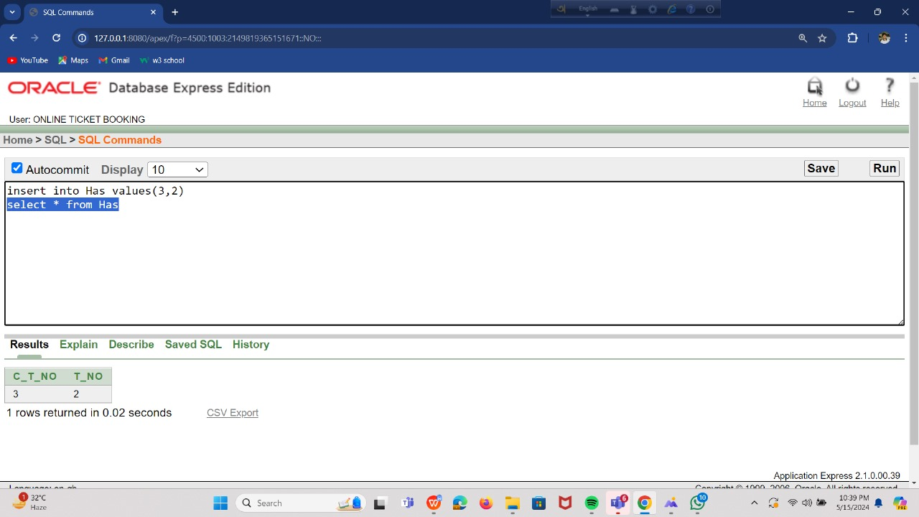
HAS

Slide 33
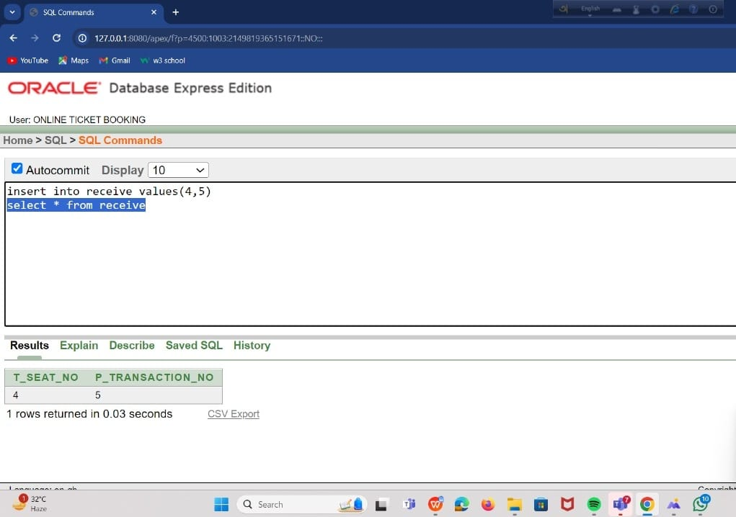
RECEIVE

Slide 34
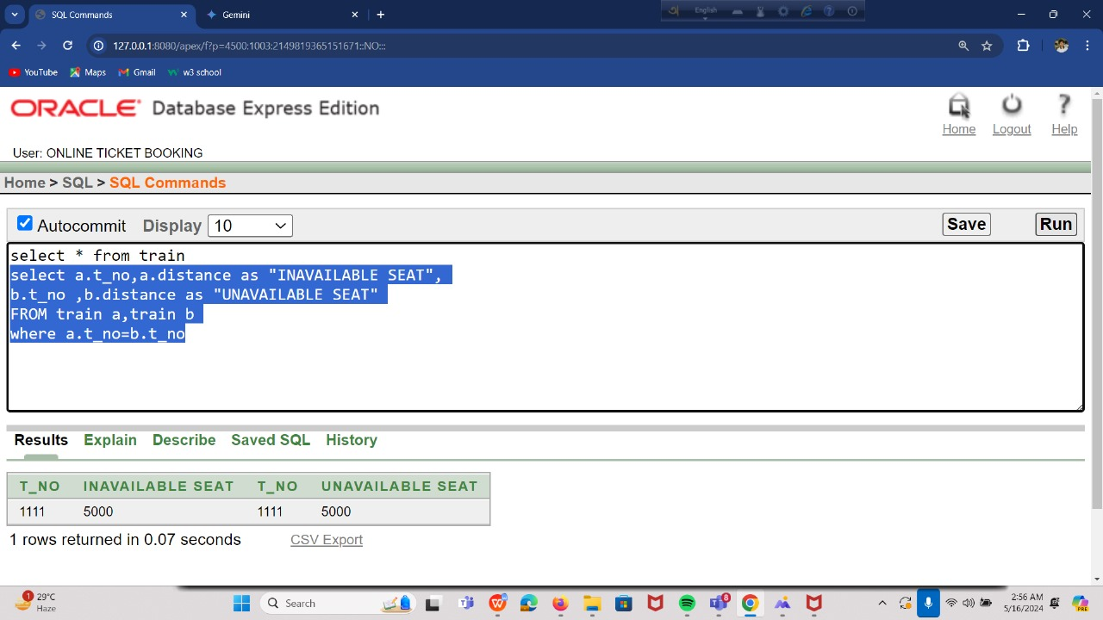
QUERY TEST
Retrieve the t_no and available seat of train where one train seat has limited available (less than the available seat of another seats) and the second seat has equal to unavailable seat.
QUERY TEST FROM SIMPLE JOINING

Slide 35
JOINING

Slide 36
CONCLUSION
Users register with the system and can then search for trains based on various criteria like source, destination, class, etc. Each train has a unique ID, type, class, and fare information. Additionally, the system can display the route of the train with stops. Once a user selects a train, the system checks for available seats. If a seat is open, the user can book it by providing payment details. Upon successful booking, a ticket is generated that contains user information, train details, and the booked seat . In essence, this ER diagram captures the essential entities (users, trains, tickets) and their relationships for managing online train ticket bookings.

Slide 37

Thank You

